Slide 1


Introduction to MongoDB Course
A presentation of Data Analytics & Data Visualisation
[James Fothergill]: Learners Journal Portfolio
MongoDB Practitioner: [v8255920| James Fothergill]:
MongoDB: Presentation of Data Analytics and Data Visualisation

Slide 2

Introduction to MongoDB Content
Unit 0: Start Here - Intro to MongoDB
Unit 1: Getting Started with MongoDB Atlas
Unit 2: Overview of MongoDB and the Document Model
Unit 3: Connecting to a MongoDB Database
Unit 4: MongoDB CRUD Operations: Insert and Find Documents
Unit 5: MongoDB CRUD Operations: Replace and Delete Documents
Unit 6: MongoDB CRUD Operations: Modifying Query Results
Unit 7: MongoDB Aggregation

Slide 3

Meet Your MongoDB Practitioner
[JAMES FOTHERGILL]
Industry Projects
39%
MongoDB Lab Assistant
SQL Server
I am enthusiastic to learn new skills and have found MongoDB to be perfect to transfer my previous SQL skill set over to a new format. I feel extremely comfortable using MongoShell’s intuitive commands and just as ease using the GUI Compass.
39%
MongoDB - Introduction
M001 MongoDB Basic Certified
39%
Data Analytics
[Relational and NoSQL Databases]
39%
Data Visualisation
39%

Slide 4

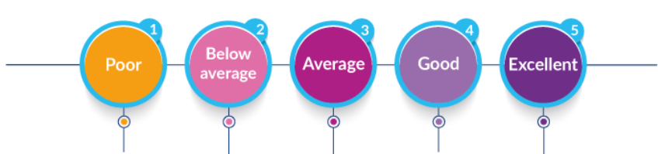
[insert name]: MongoDB Developer Journey Rating
Introduction to MonogDB
We all start as Novices who need to acquire know-how, which is the implicit or tacit knowledge of how to perform a task or function through practice, and is very often a frustrating or painful experience.
Rating Scale:
1. Poor
2. Below Average
3. Average
4. Good
5. Excellent
How was experience learning MongoDB?
1
2
3
4
5
How was your experience with MongoDB? | Rating [1-5]
Rate your MongoDB Basics skills : | 4
Rate the effort you made to cover the MongoDB learning content: | 5
Rate your time management for the MongoDB learning content: | 5
Rate the MongoDB University learning content: | 5
Rate the TU MongoDB learning content: | 5
Total Overall Average Rating: | 5

Slide 5
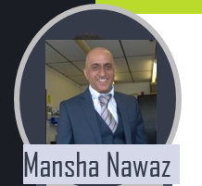

TU – MongoDB Champion
Liaising with Industry Partners for collaboration with Data Science and Business Intelligence Projects
MANSHA NAWAZ
Industry Projects
Enterprise and Business Engagement
A
Business Intelligence
MS PowerBI Enterprise
At Teesside University, we play a proactive role in supporting the regeneration of the north-east economy through extensive business engagement and enterprise support.
This mean we are committed to supporting Industry in digital innovation and research.
We have collaborated with MongoDB to introduce the Document Database technology that can support Data Analytics and Data Visualisation of your Companies Datasets.
Presented here is our MongoDb Lab Assistance and their supporting guides for your learners journey in becoming certified as a Data Analyst using MongoDB Technology.
Enjoy your journey into big data analytics and visualisation.
A
Databases – MS SQL Server
A
Big Data NoSQL - MongoDB
Specialist in: All Things Data
C
Data Science
A
Notes:
Adjust the Marks / Grade as you see fit

Slide 6


Useful Resources:
Channel
MongoDB Documentation: https://www.mongodb.com/docs/compass/current/#what-is-mongodb-compass-
MongoDB Quick Starts: https://www.mongodb.com/developer/quickstarts/
MongoDB Tutorials: https://www.mongodb.com/developer/tutorials/
MongoDB Videos: https://www.mongodb.com/developer/videos/
TU MongoDB Panapto Videos: MongoDB : Panopto
TutorialTeacher – MongoDB: https://www.tutorialsteacher.com/mongodb/
JavaPoint MongoDB: https://www.javatpoint.com/mongodb-tutorial

Slide 7
MongoDB Overview
To support MongoDB University: Introduction to MongoDB course provided here is a Learners Journal Portfolio as evidence of completion:
To support the learners journal this PowerPoint will present:
Screenshot evidence of the In Introduction to MongoDB course
With supporting MongoDB Demo walkthrough example using one of the sample MongoDB database or alternatively one of the Kaggle Data datasets supporting the SQL Database
MongoDB Collection: Loading sample MongoDB Collections and demonstrating them in Compass and Atlas.
AirBnB Listings Dataset – Contains details on AirBnB listings.
Mflix Dataset – Contains movie data.
Geospatial Dataset - Contains shipwreck data.
Alternatively you to explore any of the MongoDB Collections or Data Science Datasets from Kaggle or Github.
Olympics120 Dataset – (Kaggle) 120 years of Olympic history: athletes and results
Video Game Datasets
Football Datasets
Cricket Datasets
Music Sales Datasets
COVID-19 data – (Kaggle) - John Hopkins University USA
Notes:
Describe and provide links to mongoDB Sign Up, Overview and hyperlinks to resources for login to Atlas and Compass. Refer to MongoDB guides or TU MongoDB Guides.

Slide 8
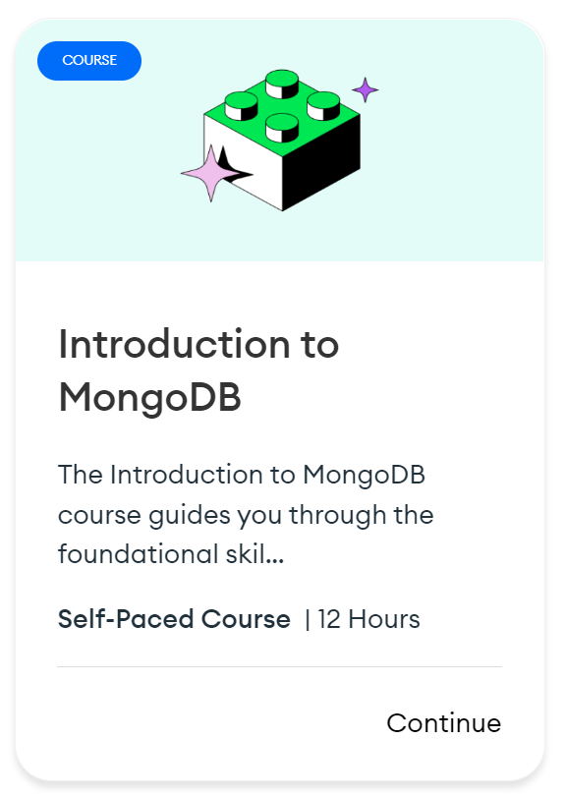

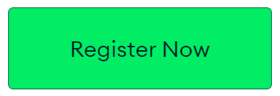
Introduction to MongoDB
The Introduction to MongoDB course guides you through the foundational skills and knowledge you need to get started with MongoDB. This includes connecting to a MongoDB database, how to conduct simple CRUD operations, and key topics such as aggregation, indexing, data modeling, and transactions.
Don't have an account? Sign Up
Introduction to MongoDB

Slide 9


CH01: What is MongoDB?
MongoDB Basics CH01
01 Welcome! - MongoDB University
MongoDB Basics CH01:
01a Explanation of MongoDB Atlas
You only need to know how to create a cluster.
The cluster and performance management is of limited relevance for our purposes.

Slide 10
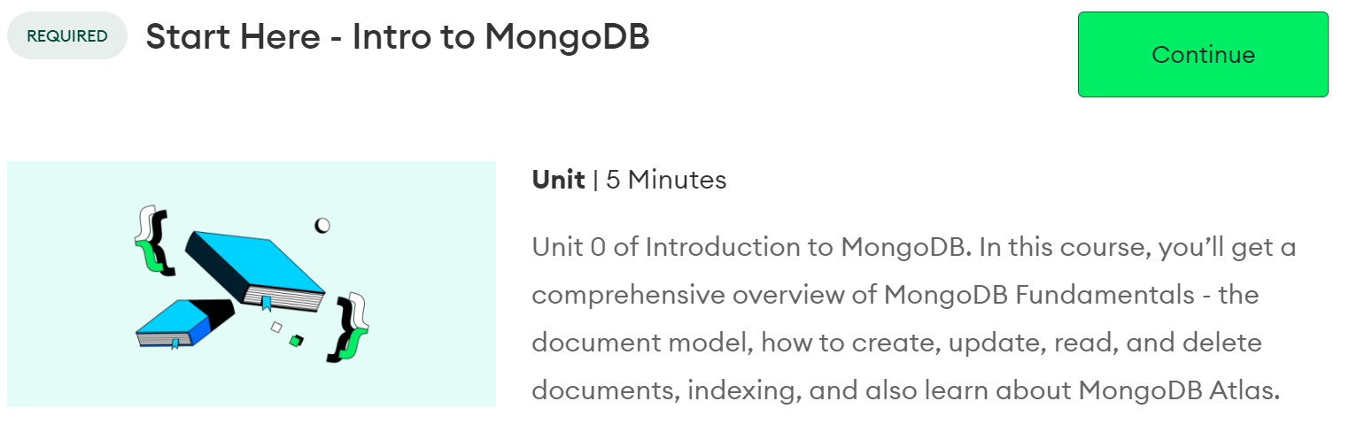
Unit 0: Start Here - Intro to MongoDB

Slide 11
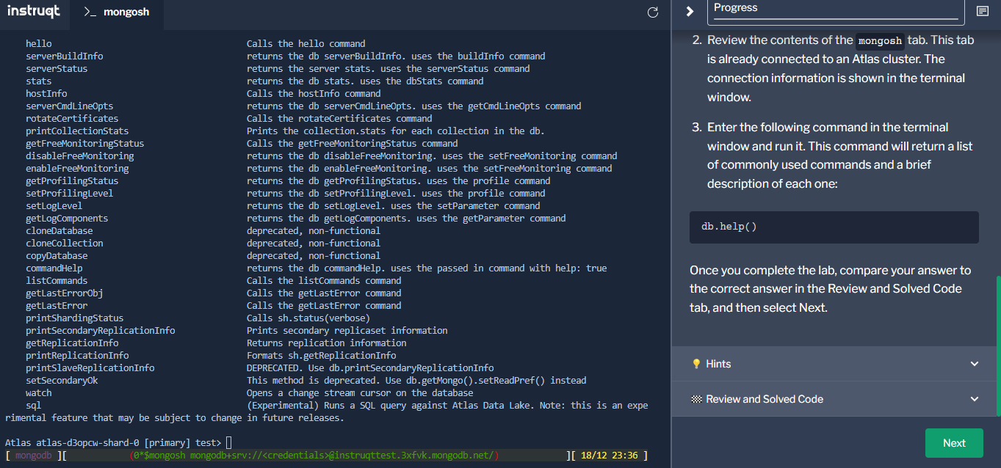
The first lab will cover the command line interface mongosh.
In this introductory lab the user must simply type “db.help()” into the command line. This will then display a list of commonly used commands and a brief description of each command.
getName – returns the name of the database.
getUser – returns the information about the specified user

Slide 12
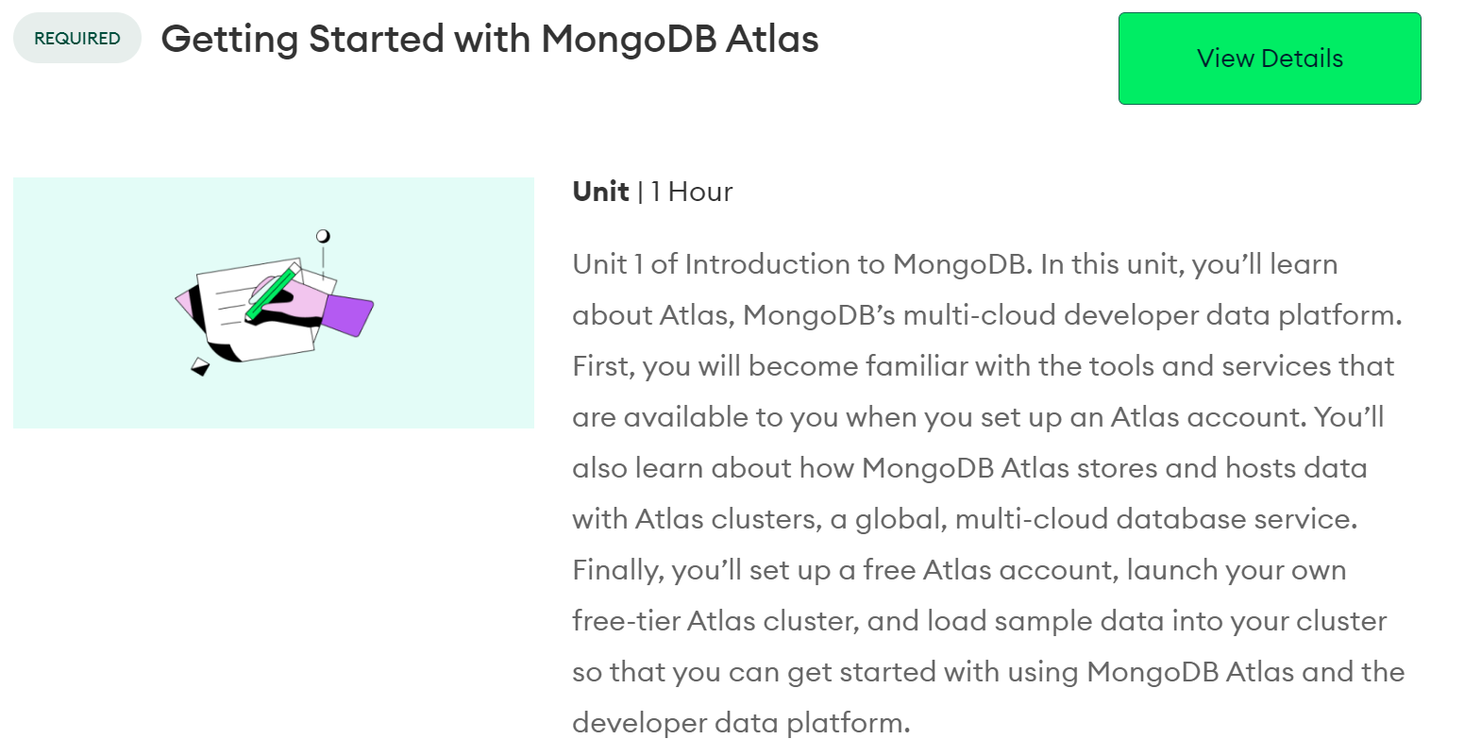
Unit 1: Getting Started with MongoDB Atlas

Slide 13
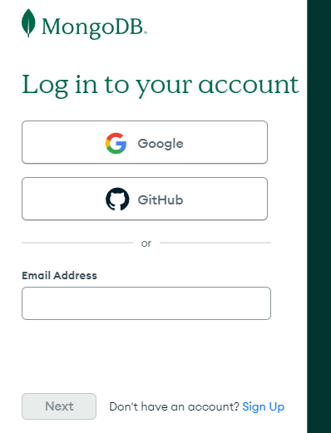
Signing up for a MongoDB account is a simple process.
You have the choice of using your own personal email,
your Google account or even GitHub.
For the following presentation I opted to use my Teesside University account and two factor authentication.

Slide 14
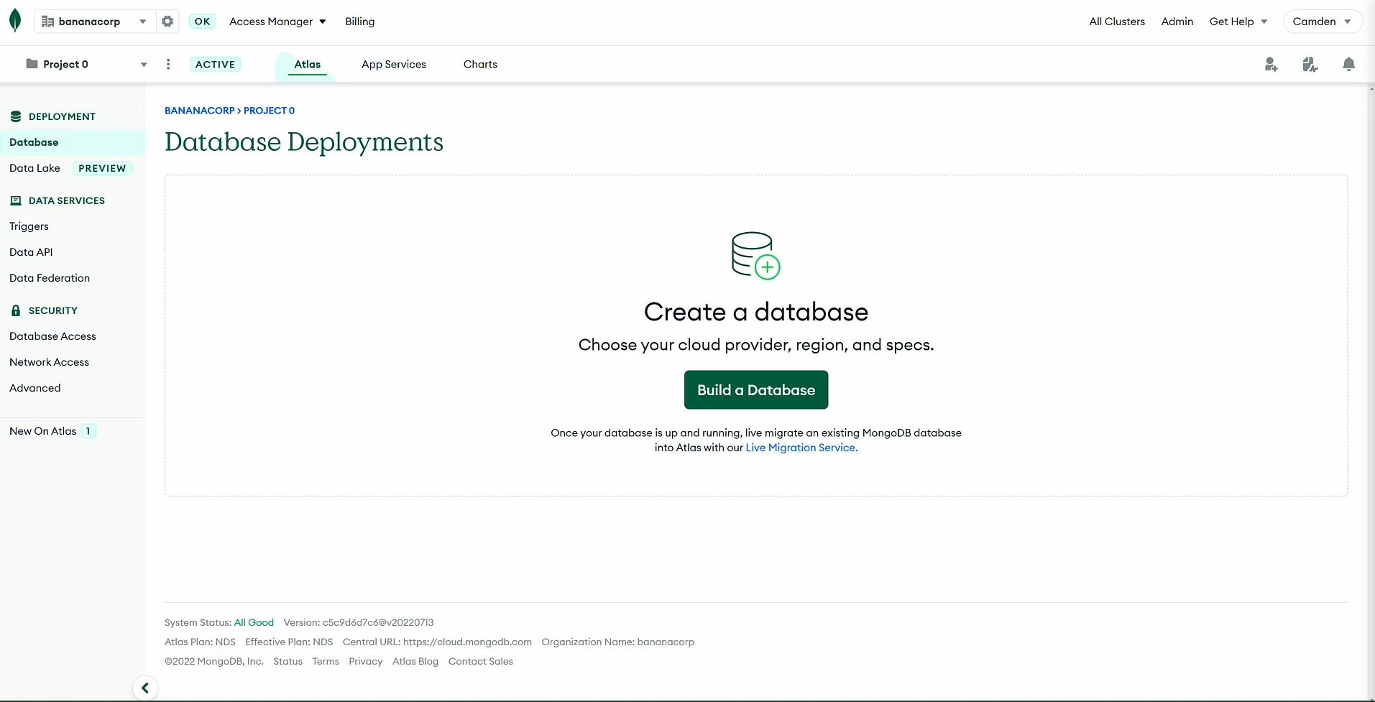
Getting started with MongoDB Atlas
Organisations – Allow you to group and define users and teams and to grant them access to projects.
Once signed up for a MongoDb account, click the ‘Build a Database’ button
Projects – Allow you to organise and define resources, like database clusters.
A common way to use this feature is to create separate projects for development, testing and production.

Slide 15
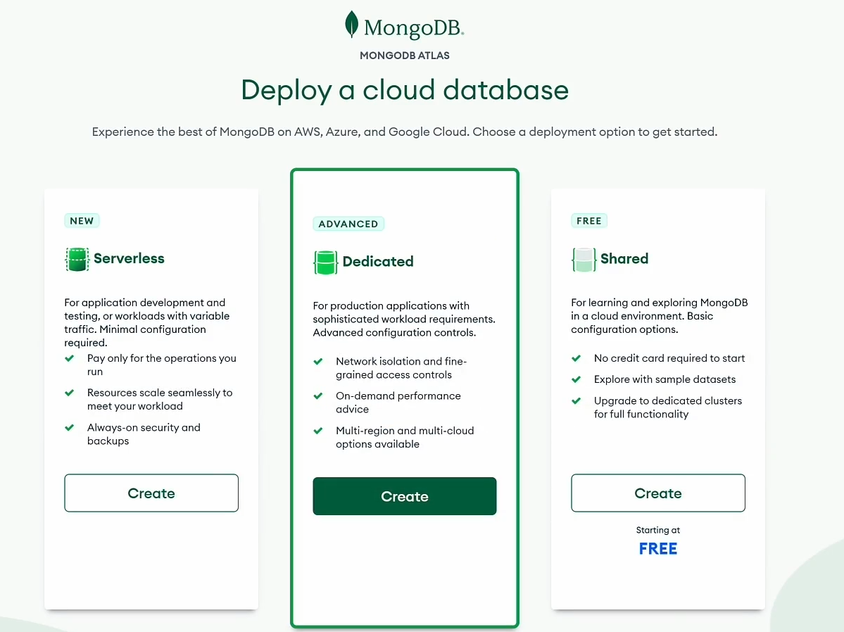
MongoDB has two types of deployments:
Serverless instances – Which scale on demand and are a great option for applications with highly-variable or sparce workloads over time. This is the best option if you don’t know what hardware you need, or if you just want to use a serverless architecture.
You only pay for resources that you use with Serverless.
and Clusters:
Shared – A cluster is several MongoDB servers working together.
Shared clusters are smaller and include a free tier.
Dedicated – Dedicated clusters are larger, can be customised to needs. Have options for low and high traffic applications that have cluster scaling enabled by default and run advanced security features.
Select the Free, Shared option by clicking create.

Slide 16
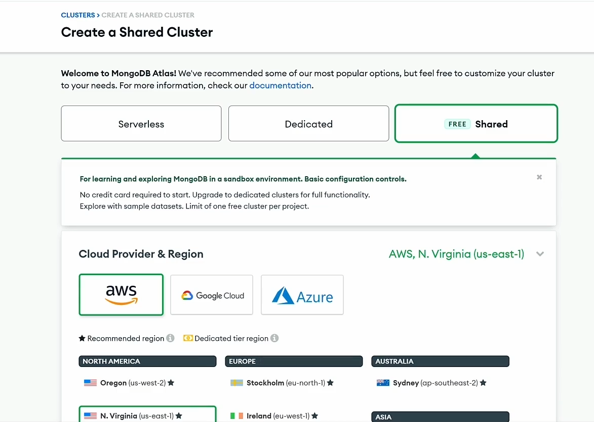
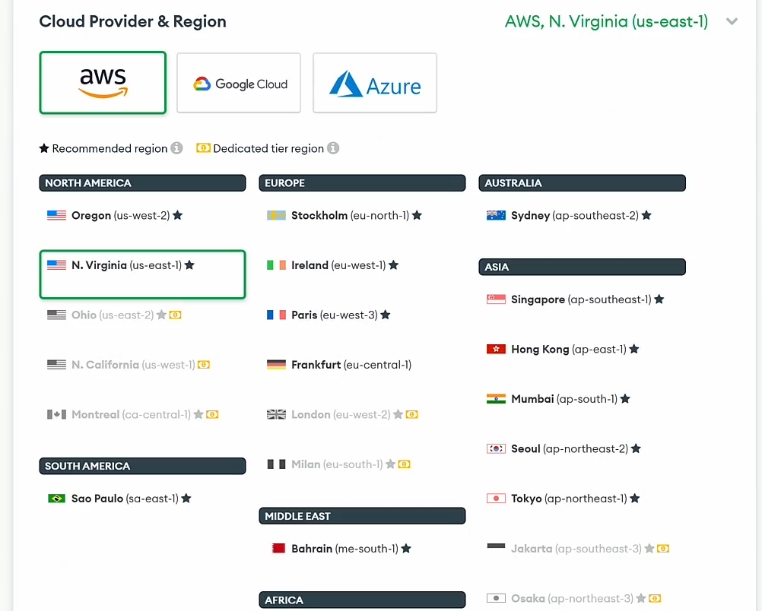
Select the Free Shared (m0) option for the shared cluster and choose the cloud provider and region that is closest to you. Leave the cluster name as Cluster0. Click create cluster when ready to proceed.

Slide 17
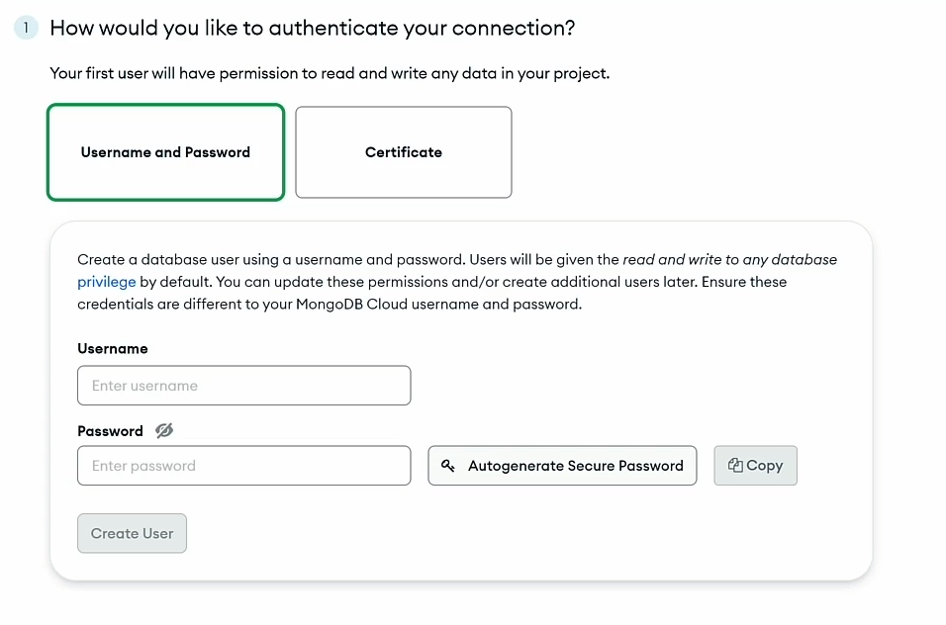
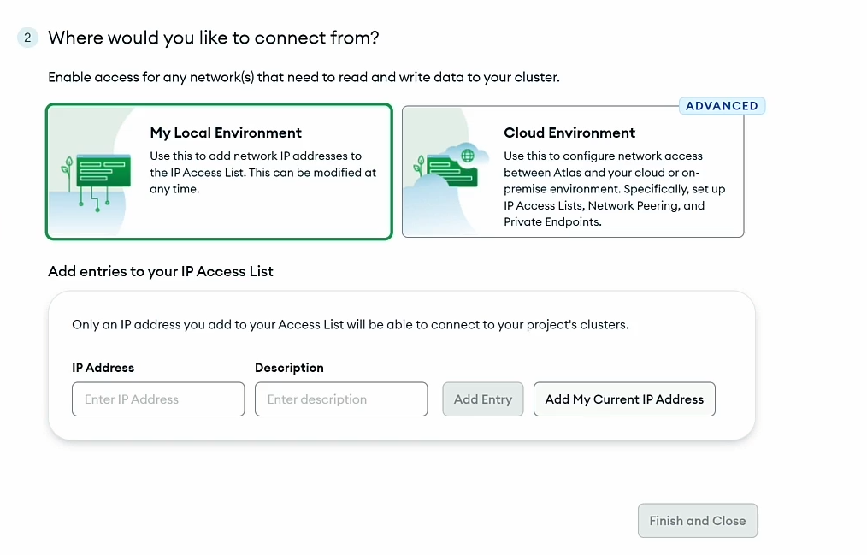
By default MongoDB is created with no users and no IP address is allowed to access the database, outside of the Atlas system itself.
Create a username and password and select ‘My Local Environment’ as the place you’d like to connect from. Then click ‘Add My Current IP Address’ to add your IP address to the Access control list and finish and close.

Slide 18
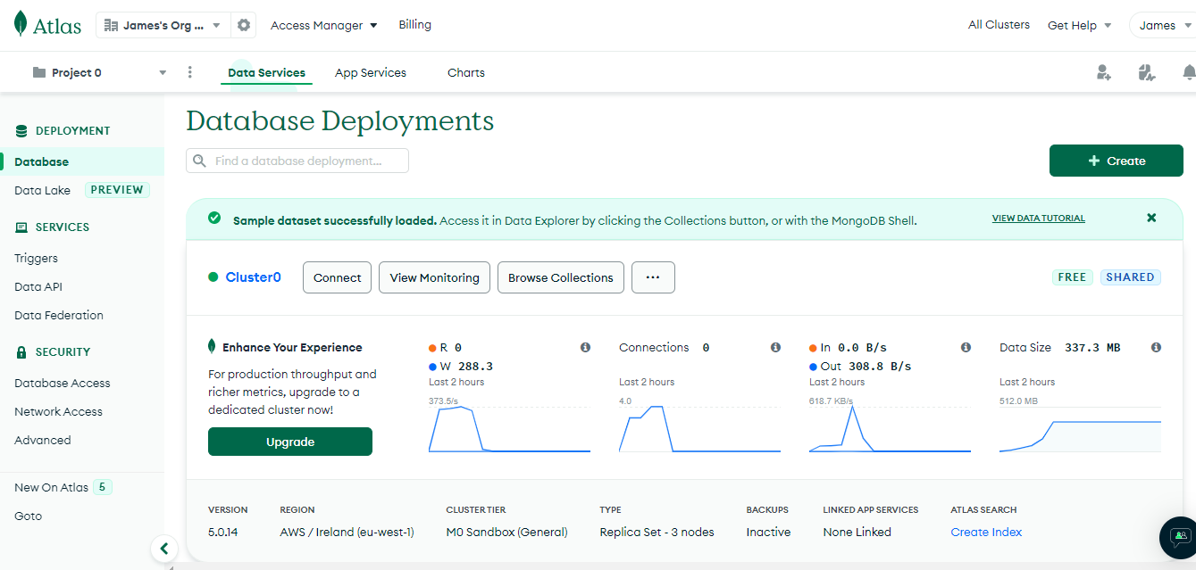
To add data to the sample dataset, click the ellipsis next to browser collections. Then click load sample dataset.
Once complete click on browse collections.
This will open Atlas Data Explorer, which will allow you to view, filter and modify data.

Slide 19
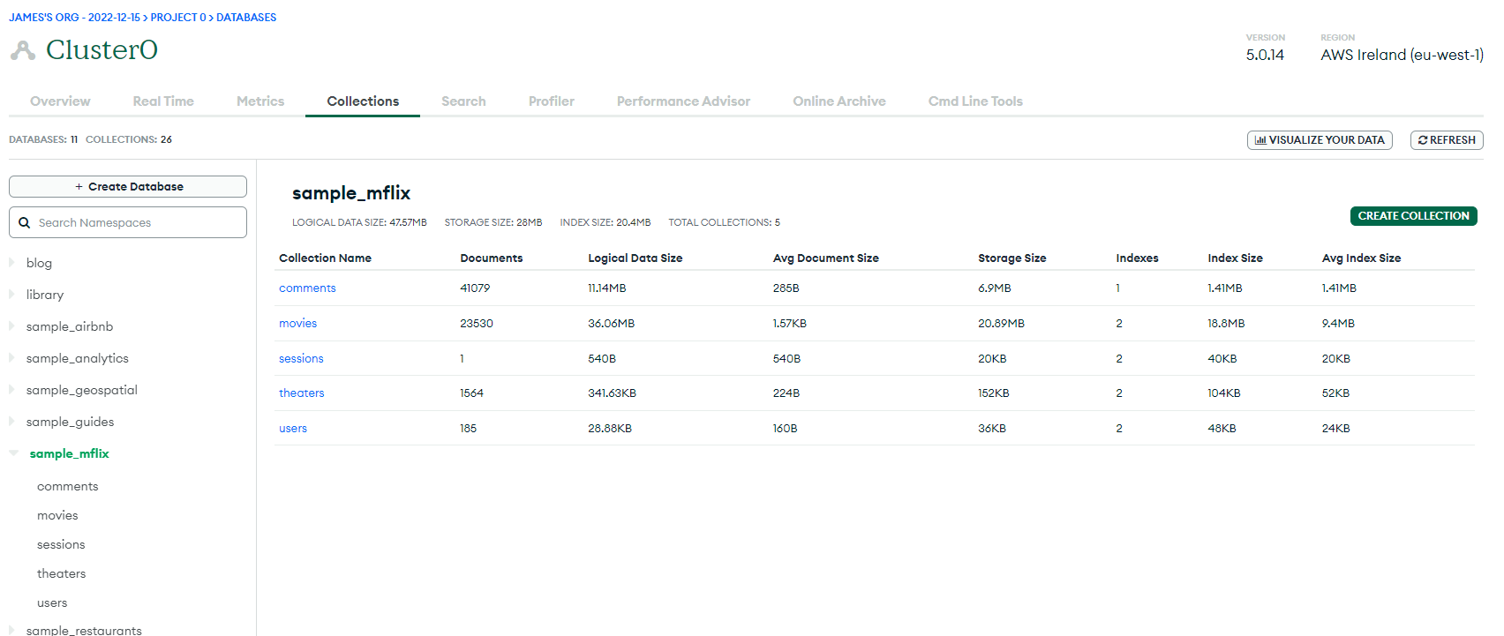
For this course I’ll be using the sample_mflix database, which will concentrate on movies.
Clicking the database will show a list of collections available in that database

Slide 20
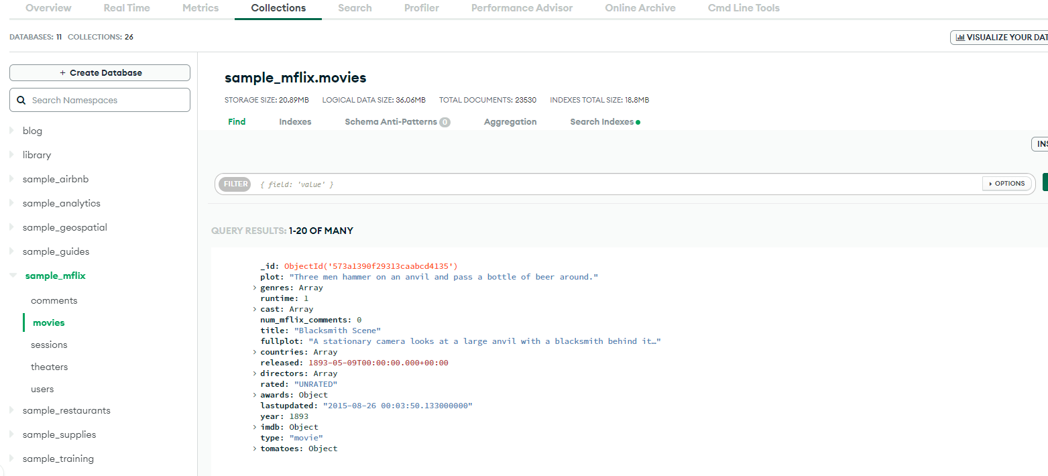
Clicking movies will show a list of movies, staring from the earliest known recording.
If we want to filter through the records, we can enter a search query into the filter search bar
The syntax for searching is {field: value}

Slide 21
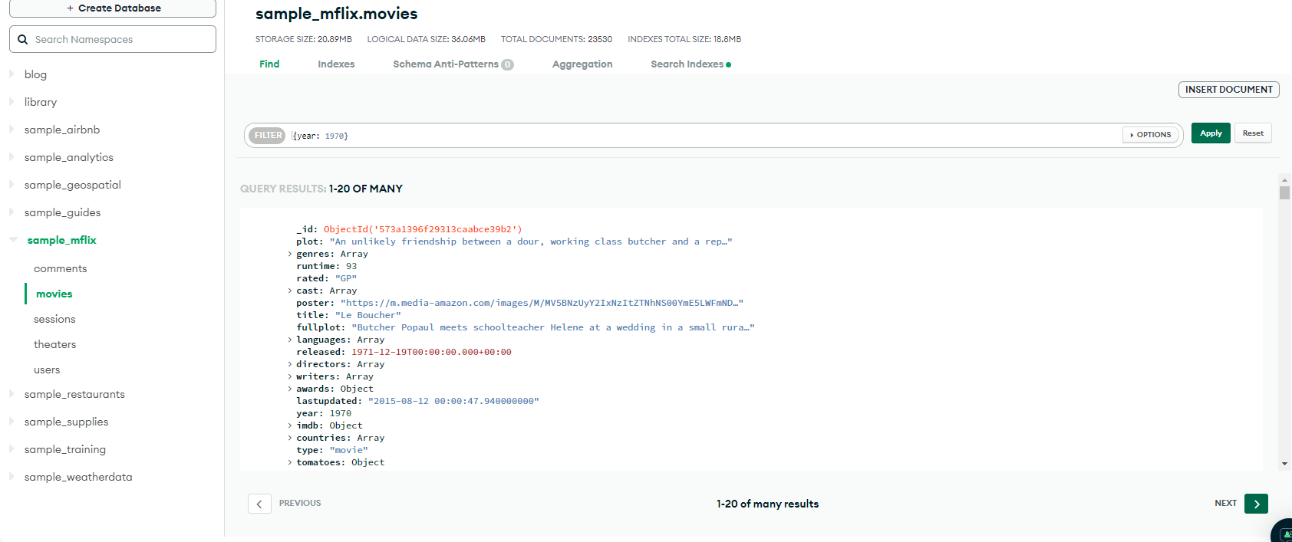
For this search we will be filtering for films made in 1970.
To return the desired results type {year: 1970} into the search box and a result of 1-20 of many return (the list is much larger but by default results are shown 20 per page).

Slide 22
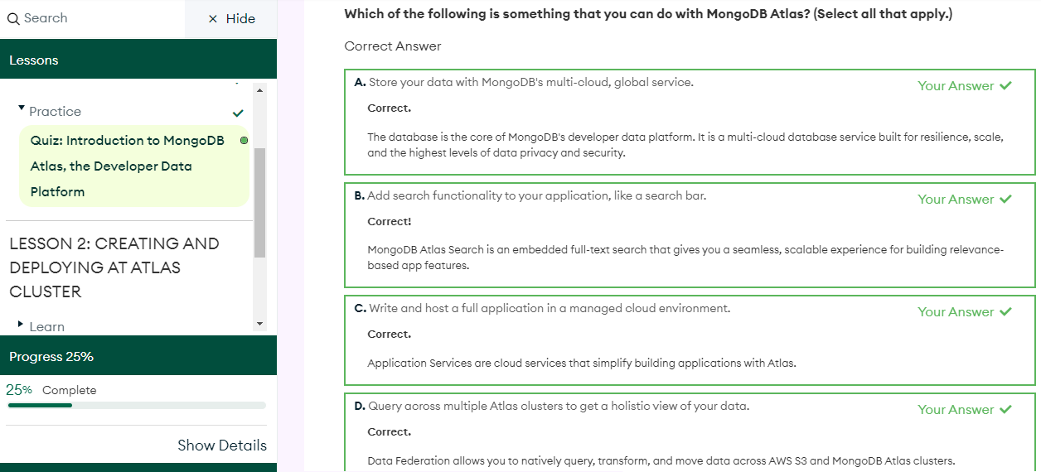
MongoDBUniversity has a variety of quizzes at the end of each chapter. While learning, I decided to write a journal of everything that I learned throughout the chapters, as I plan on using MongoDB in future projects. I found this information useful when answering the quizzes.

Slide 23
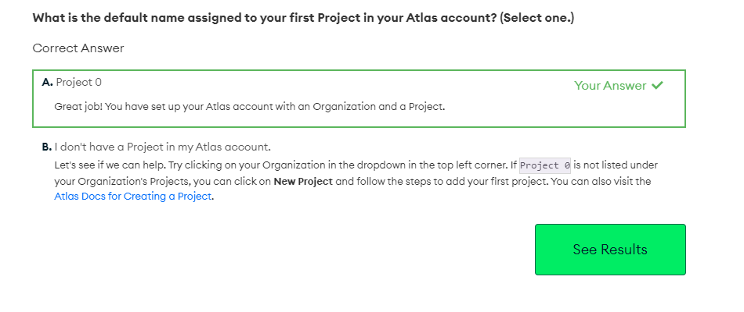
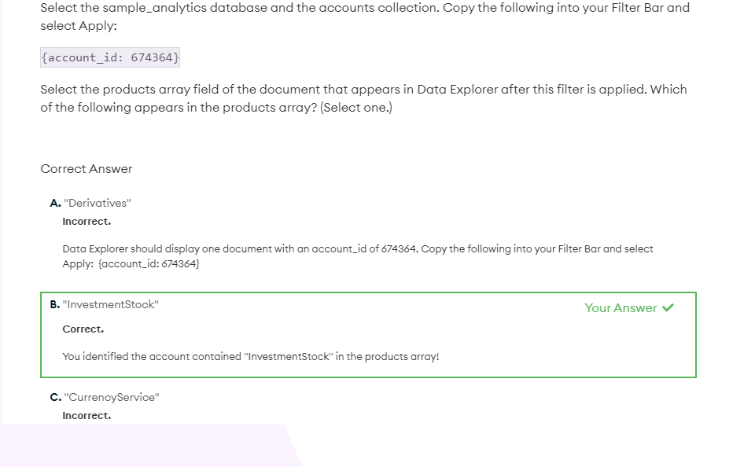
Some quizzes are easier than others. I found being able to check on Atlas in real time a huge help.

Slide 24
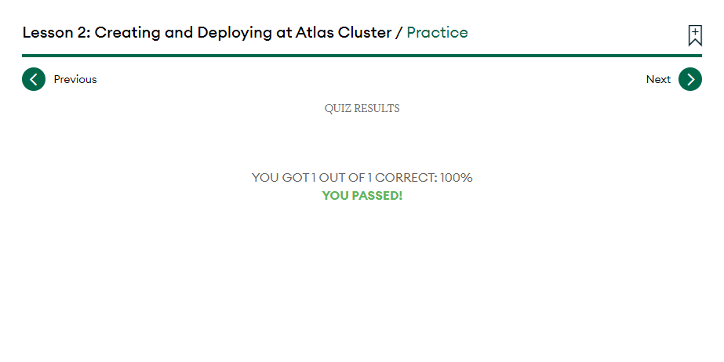
At the end of the quiz you’re graded on the answers you’ve given. You’re also able to check answers and see which you’ve gotten wrong.

Slide 25
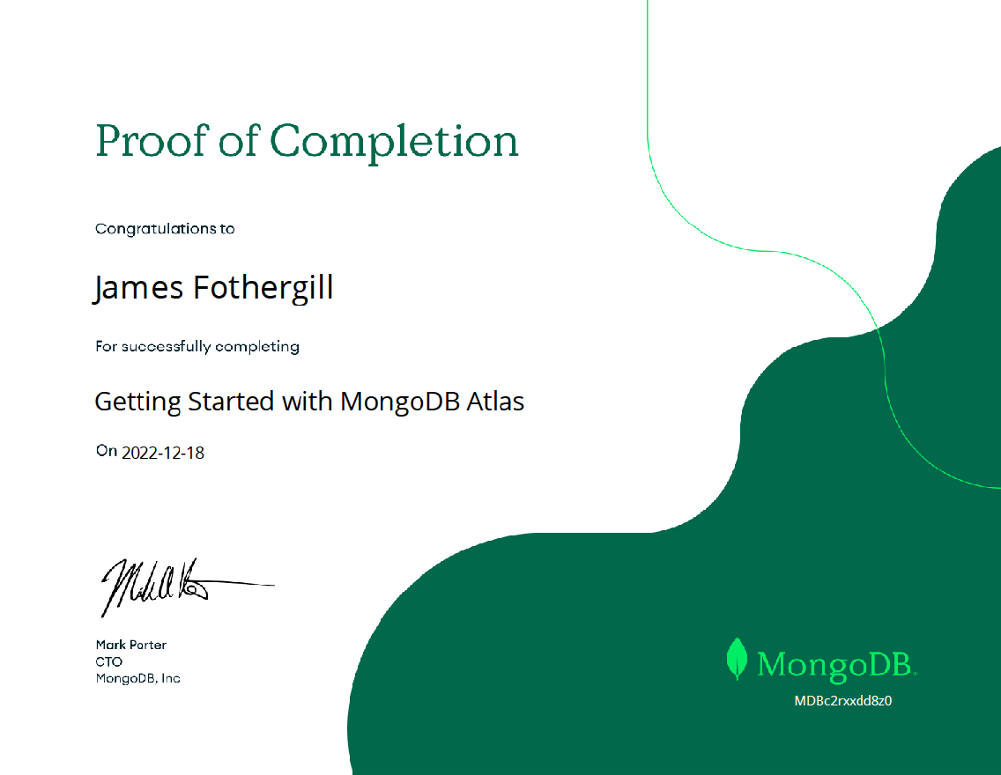
MongoDBUniversity has a section for your transcript and certificates that you pick up at the end of most chapters.

Slide 26
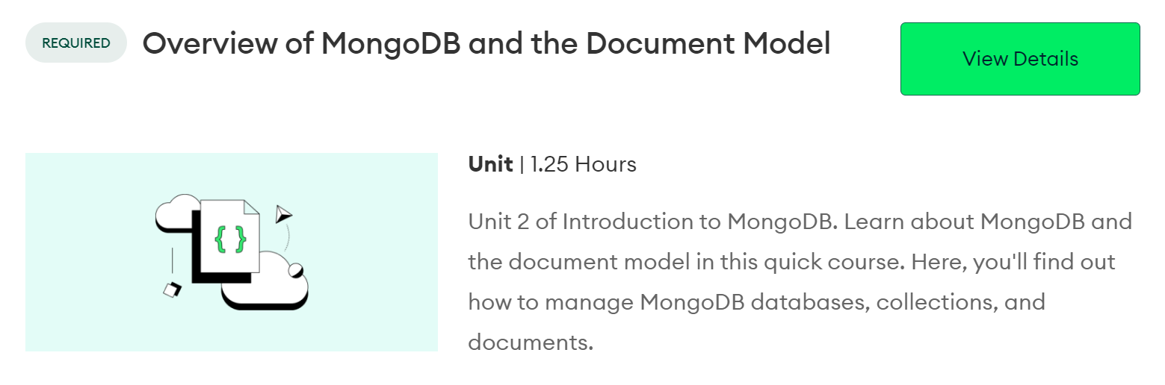
Unit 2: Overview of MongoDB and the Document Model

Slide 27
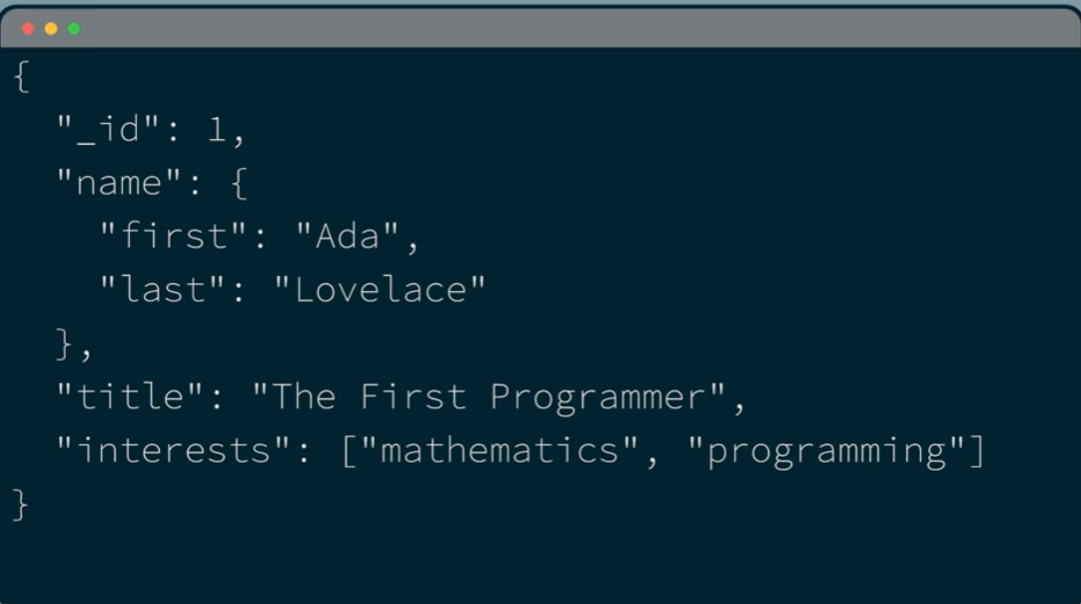


Document:
The basic unit of data in MongoDb
Collection:
A grouping of documents
Database:
A container for collections
MongoDB is a general purpose document database.
MongoDB database is at the core of Atlas.
MongoDB is a general purpose document database.
The MongoDB database structures data in documents, which are very similar to JSON.
This is fundamentally different to how relational data is stored in rows and columns.
Documents correspond to objects in code and match how we think in code, so make them intuitive to work with.
Documents have drivers that allow them to be used with any major programming languages.

Slide 28
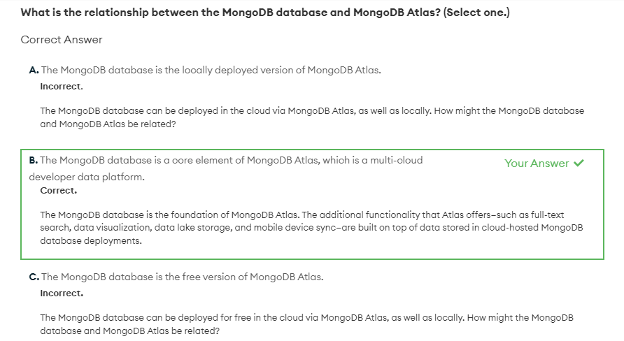
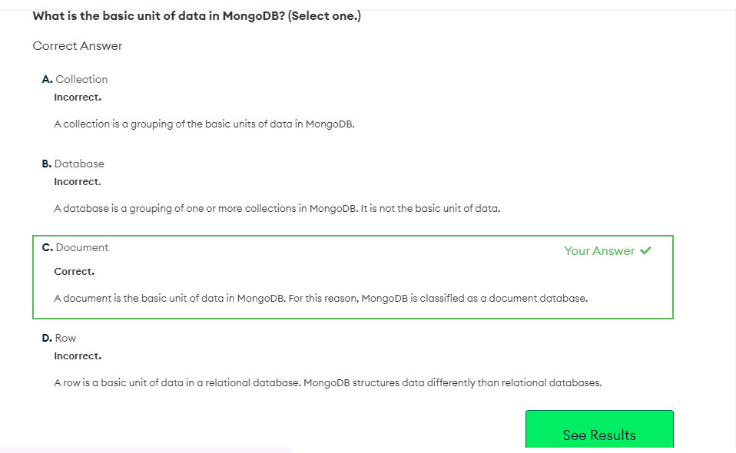
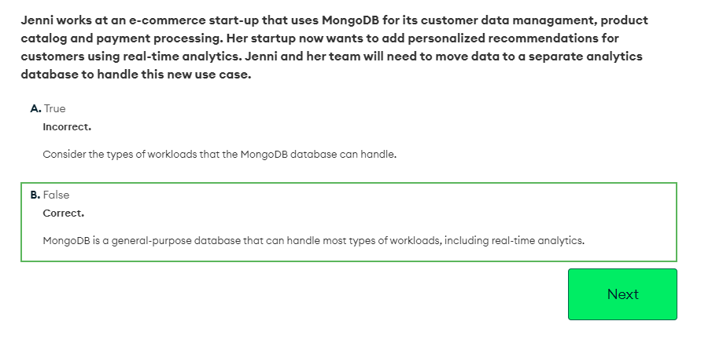
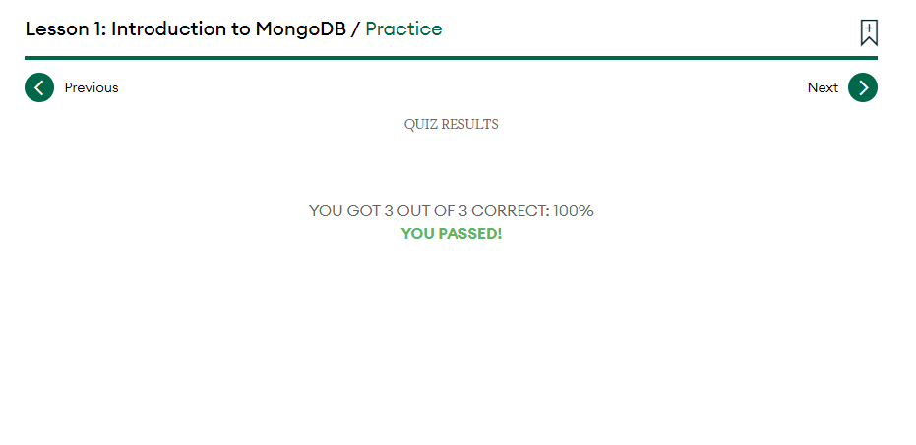
Now time for a quiz:

Slide 29

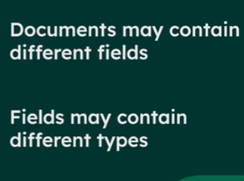

Documents are displayed in JSON though stored in BSON (Binary JSON)
The data types supported by documents are Dates/Numbers/Object ID’s … among others.
ObjectID is a unique identifier. In the database every document requires an _idfield that acts as a primary key. If a document is inserted that doesn’t include an _idfield, MongoDB will automatically give it one.
MongoDB supports a flexible schema model and polymorphic data.
This allows documents with different structures to be stored in the same collection together.
To make schema changes in in MongoDB, update classes to include new fields.

Slide 30
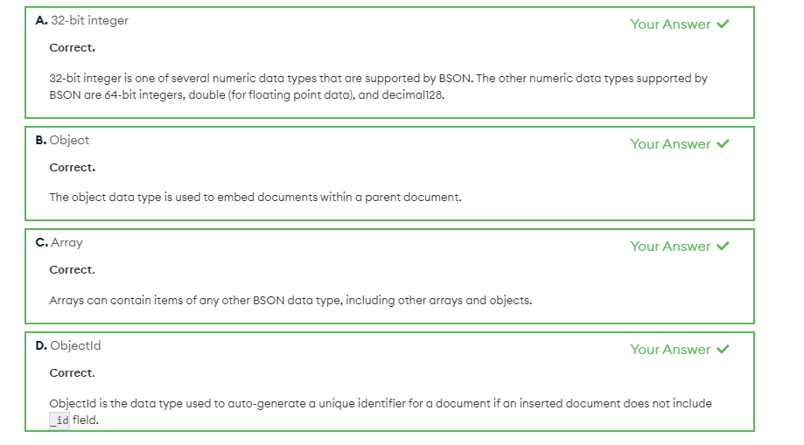
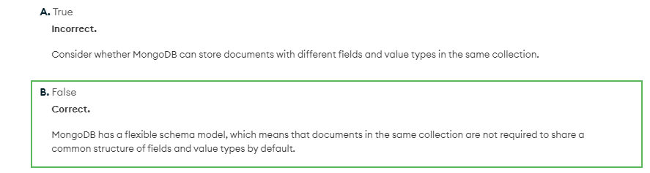
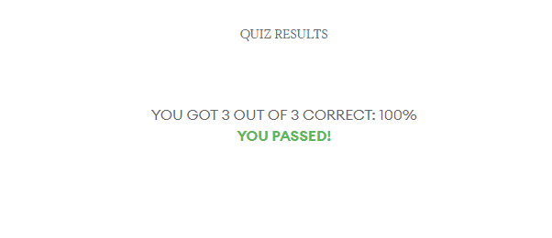
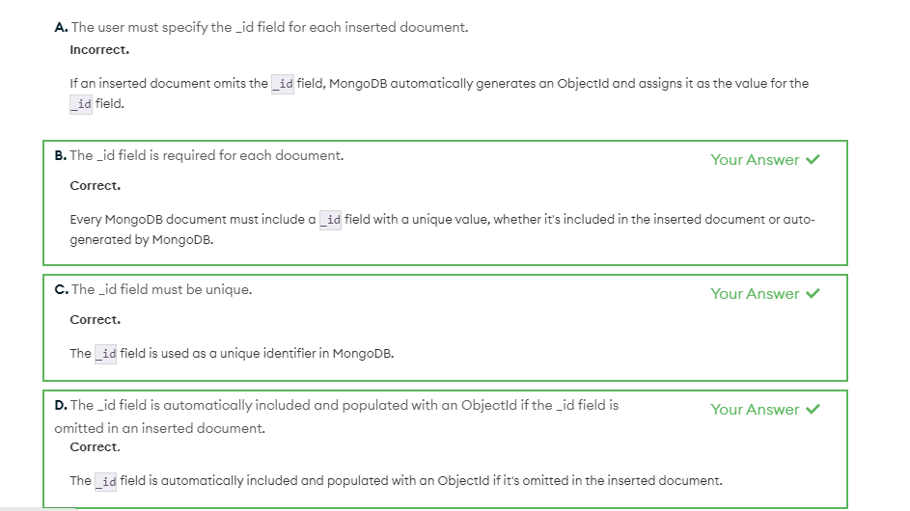
Time again for another quiz.

Slide 31
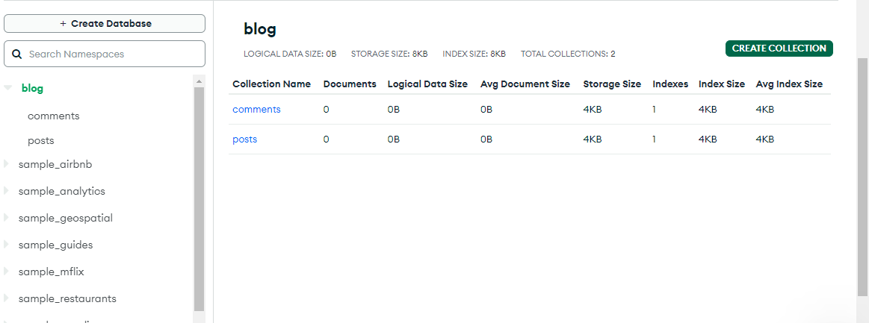
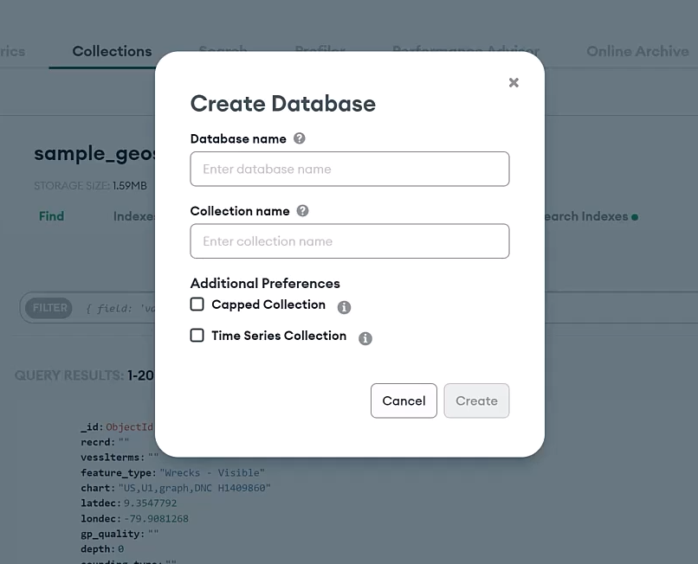
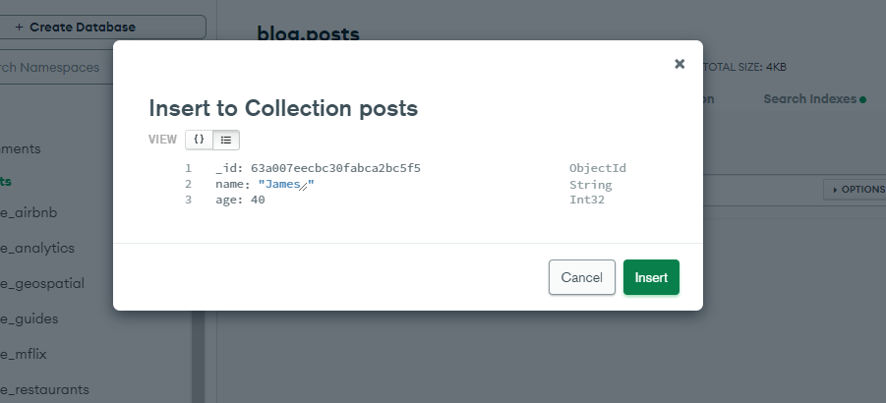
Create a new database
In collections click + Create Database and enter ‘blog’ as the Database name.
Then for the Collection Name type ‘posts’
Next click Create Collection and in the Collection Name and type comments.
Then click on posts and click on Insert Document. Add the fields name: as a String and age: as an Int32 and input data to both. We now have a database and have given it some data.

Slide 32
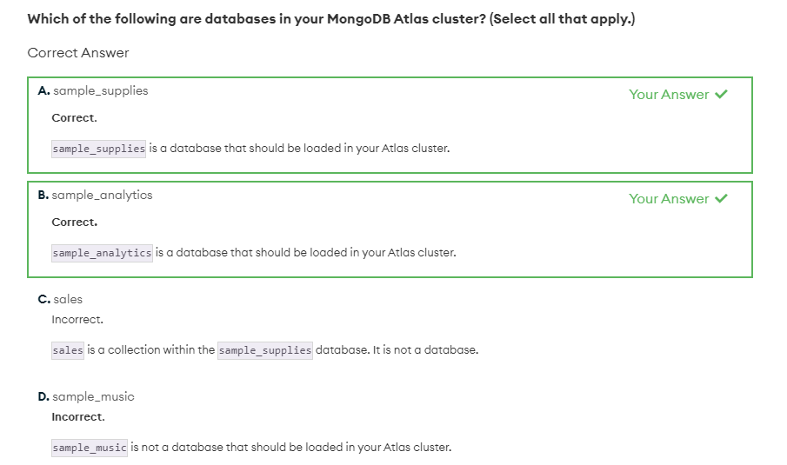
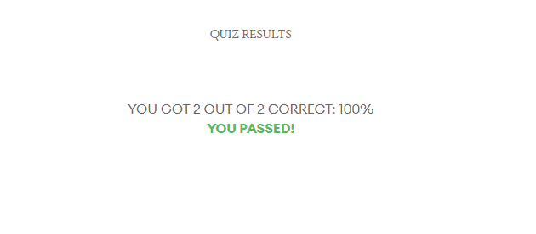
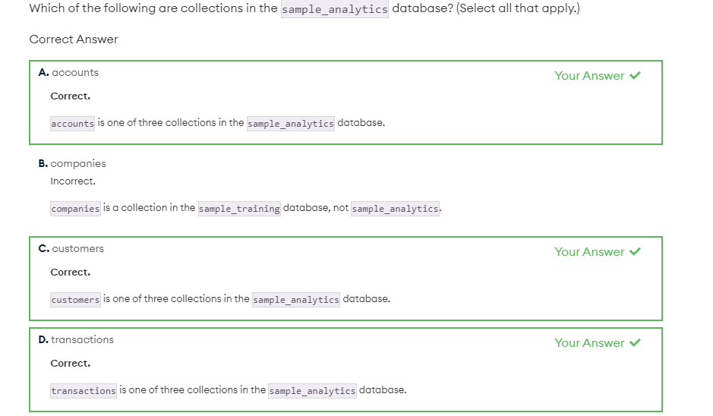
Time for another test.

Slide 33
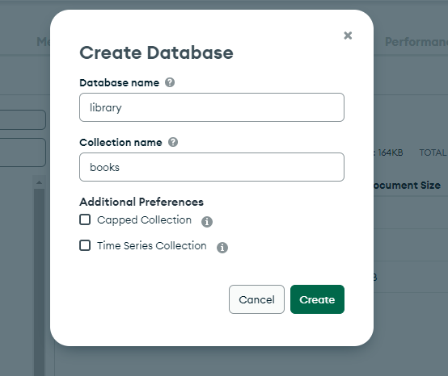
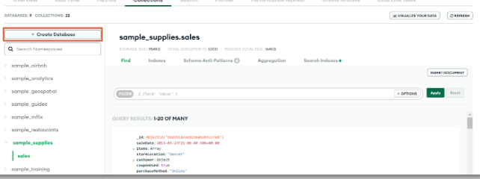
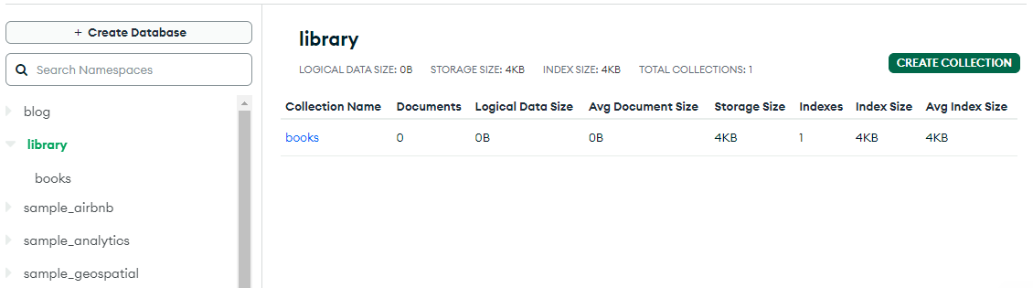
Let’s try making another database.
Enter ‘library’ for the Database name and ‘books’ for the Collection name
In Collections, click +Create Database

Slide 34
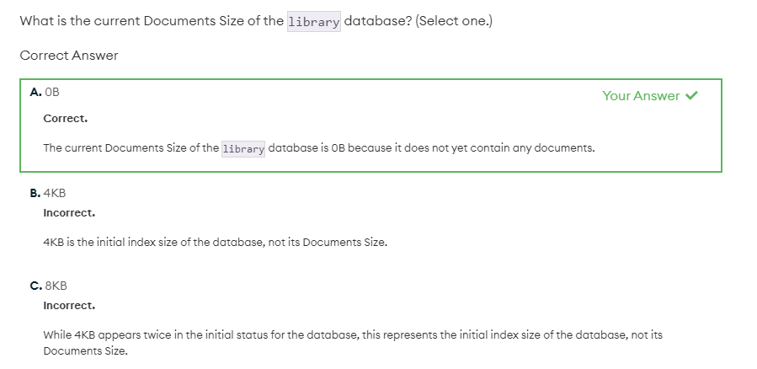
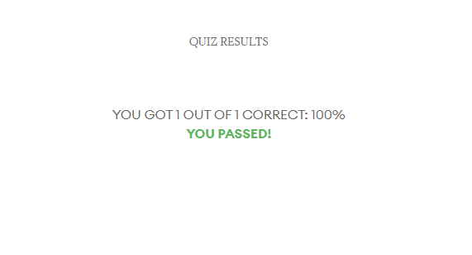
A test of our observational skills

Slide 35
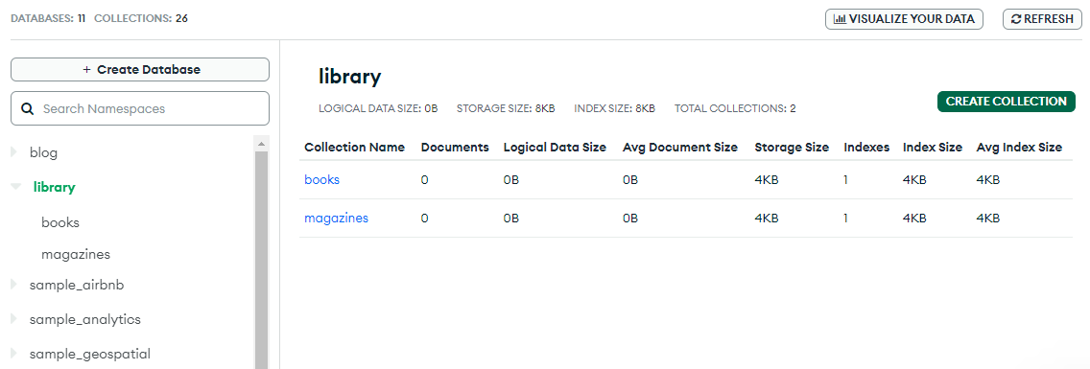
Click Create Collection and enter magazines as the collection. We now have two collections

Slide 36
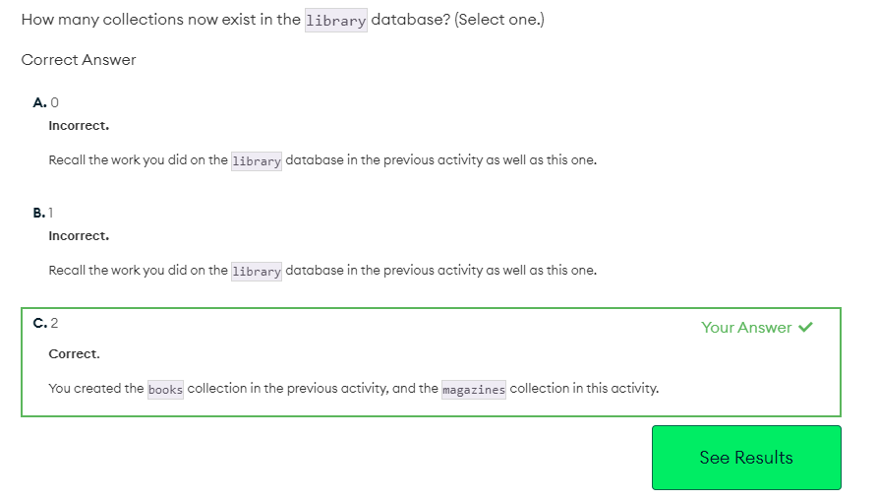
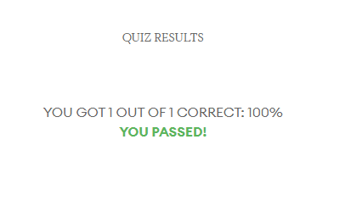
One final quiz ends the Unit

Slide 37

Unit 2 is now complete

Slide 38
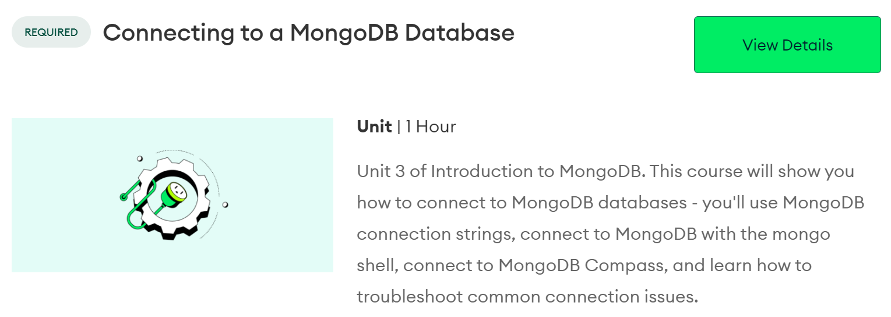
Unit 3: Connecting to a MongoDB Database

Slide 39
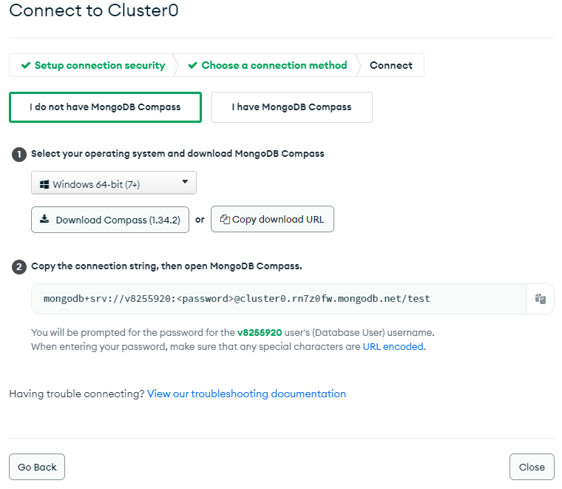
The MongoDB connection string allows us to connect with our clusters and work with our data.
The connection string can be used to connect to MongoShell, Compass or other applications.
MongoDB provides two formats for the connection string:
Standard Format – Used to connect to standalone clusters, replica sets or shared clusters.
DNS Seed List Format – Provides DNS server list to our connection string. Gives more flexibility of deployment. With the ability to change servers in rotation, without reconfiguring clients.
To see the connection string click on the connect button in database deployments.
For this example I’ll be using Compass.

Slide 40

To break down the Connection String:
mogodb = Identifies the type of string
srv = sets TLS Security to true and tells MongoDB to use the DNS seed list
<username:password> = same un & pw for Atlas dashboard
@cluster0.usqsf.mongodb.net = host and optional port numbers to our datatbase
if not specified, Mongo will default to port: 27017
?retryWrites=true&w=majority = any options we want to include (connection timeout, TLS & SSL, connection pooling
and read and write concerns)

Slide 41


Here we see the connection string and Compass connected.

Slide 42


Quiz time again..

Slide 43



And for Mongo Shell..

Slide 44

Compass has quite a few additional tabs to Atlas:
Aggregations: Allow the user to compose aggregation statements to run against the collections.
Schema: Will help the user to analyse the structure of their documents.
Explain Plan: Helps to understand the performance of the specific queries that you’re running against your database.
Indexes: Allows the user to see indexes running on specific collections and understand the performance of queries.
Validation: Allows the creation of rules to enforce the structure of documents on update and insert statements.

Slide 45



Time for a quiz:

Slide 46



And a quiz on Compass and Applications..

Slide 47

Most connection errors are caused by human error (wrong username or password)
Other common reasons are Network Access errors.
These can be that the user doesn’t have their IP address in the Access control list. This can be done from the Atlas dashboard.

Slide 48



Connection error quiz…

Slide 49

This concludes Unit 3

Slide 50

Unit 4: MongoDB CRUD Operations: Insert & Find Documents

Slide 51

insertOne()
db.<collection>.insertOne()
db.grades.insertOne()
If the collection doesn’t exist, MongoDB will create it for you when you use insertOne()
Pass the document that you want to insert as a parameter inside of the insertOne() method. Running the command shows that it was successful and an automatically generated ObjectId is returned.

Slide 52


insertMany()
db.<collection>.insertMany([
<document 1>,
<document 2>,
<document 3>
])
Running the command shows three ObjectId’s have been generated

Slide 53

Lab: inserting a document
Insert
{ "account_id": 111333, "limit": 12000, "products": [ "Commodity", "Brokerage" ], "last_updated": new Date() }
Into the accounts collection

Slide 54

Lab: insert many documents
Insert
{ "account_id": 111333, "limit": 12000, "products": [ "Commodity", "Brokerage" ], "last_updated": new Date() }, { "account_id": 678943, "limit": 8000, "products": [ "CurrencyService", "Brokerage", "InvestmentStock" ], "last_updated": new Date() }, { "account_id": 321654, "limit": 10000, "products": [ "Commodity", "CurrencyService" ], "last_updated": new Date() },
Into the accounts collection

Slide 55



Time for a quiz..

Slide 56



Find()
Specify the field we’re interested in, followed by $in and an array of values that we want to match.
$in
db.<collection>.find()
To find a specific document use:
{field: {$eq:<value>}}
Or
{field:<value>}
Example:
Sample_mflix
db.movies.find({rated: “G” })
To find all “G” rated movies
Example:
db.movies.find({rated: { $in: [“TV-PG”, “G”] }} )

Slide 57




Lab:

Slide 58



Quiz time..

Slide 59




$ gt (Greater Than)
$ lt (Less Than)
$lte (Less Than Or Equal To)
$gte (Greater Than Or Equal To)
<field>: {<operator>:<value>}
Example:
db.movies.find({“runtime”: {$gt:65}})
For all movies with a runtime over 65 minutes
db.movies.find({“runtime”: {$lt:65}})
For all movies with a runtime under 65 minutes
db.movies.find({“runtime”: {$lte:65}})
For all movies with a runtime 65 minutes or under
db.movies.find({“runtime”: {$gte:65}})
For all movies with a runtime 65 minutes or over

Slide 60




Lab:

Slide 61




Lab:

Slide 62



Quiz time..

Slide 63


Query Arrays in documents
Searching for every document with a field we specify
db.movies.find({cast: “Marlon Brando”})
Returns all documents with “Marlon Brando”
Search for a value within an Array
db.movies.find({cast:{$elemMatch:{$eq:”Leslie Phillips”}}})
Returns all documents within an array with an element equal to “Leslie Phillips”

Slide 64

Using sample_restaurants to find all restaurants with a grade of “A” and score greater or equal to 5 by searching withing the grades Array
Searching within an Array for multiple conditions.
(Has to be an Array and not an Object)
Hint: Ctrl + L clears screen

Slide 65


Lab

Slide 66



Quiz

Slide 67

$and
db.<collection>.find({
$and: [
{<expression>},
{<expression>},
…
]
})
If any one of the criteria isn’t met in a given document, the document will not be included in the results.
Searching for all documents that match the genre horror and director Alfred Hitchcock

Slide 68

$or
db.<collection 1>.find({
$or: [
{<expression 1>},
{<expression 2>},
…
]
})
Searching for documents by the year 1980 or 1970

Slide 69

Using $and + $or
Searching for movies with the year 1970 or 1980 and cast of Clint Eastwood or Charles Bronson

Slide 70




Lab

Slide 71



Quiz

Slide 72


Slide 73


How to Import and Export Datasets
Review: MonfoDB documentation: Import and Export Data
MongoDB Compass
04 Exploring Datasets in Compass
MongoDB Compass
04a Import Json and CSV
We export SQL Server Views into CSV or Json format to import using MongoDB Compass into Database Collections on our Atlas cloud.
Kaggle / Github are our developer platforms for sharing Industry Datasets.

Slide 74
MongoDB Sample Databases
To learn how to load the sample data provided by Atlas into your cluster, see Load Sample Data.
Sample MongoDB Colections Data
We can explore any of the MongoDB Collections or Data Science Datasets from Kaggle or Github.
Olympics 120 year Dataset
Video Game Datasets
Football Datasets
Cricket Datasets
Music Sales Datasets
COVID-19 data
Sample AirBnB Listings Dataset
Sample Analytics Dataset
Sample Geospatial Dataset
Sample Mflix Dataset
Sample Restaurants Dataset
Sample Supply Store Dataset
Sample Training Dataset
Sample Weather Dataset

Slide 75

Samples Datasets used in Lab Guides by Mansha Nawaz
MongoDB University Online Course
The sample_training database contains a set of realistic data used in MongoDB Private Training Offerings. This dataset is based on public available data sources such as:
MongoDB Compass: Keynote Video Complete In-depth Tutorial [all features]
Review for a quick overview of MongoDB
Crunchbase Data,
NYC OpenData,
Open Flights and
Citibike Data.
These realistic datasets are used by our students to explore MongoDB’s functionality across our private training labs and exercises.
Github: Citibike Datasets
Citibike Queries
Citibike – more datasets
Citi-Bike-Analytics - MongoDBVisualisations Solution

Slide 76

Unit 5: MongoDB CRUD Operations: Replace & Delete Documents

Slide 77




replaceOne()
db.collection.replaceOne(filter,replacement,options)
3 arguments
before
After

Slide 78



Lab

Slide 79



Quiz

Slide 80






updateOne(
<filter>,
<update>,
{options})
$set
Adds new fields and values to a document
Or
Replaces the value of a field with a specified value
$push
Appends a value to an Array
If absent, $push adds the Array field with the value as its element
Upsert
Insert a document with provided information if matching documents don’t exist
before

Slide 81




Lab

Slide 82



Lab

Slide 83


Lab

Slide 84



Quiz

Slide 85



findAndModify()

Slide 86


Lab

Slide 87



Quiz

Slide 88



updateMany()
Filter
Update
Options

Slide 89


Lab

Slide 90


Quiz

Slide 91




deleteOne()
deleteMany()
Sorry, Pete Smith, time to go!
Time to delete all genres with the category “Drinking”

Slide 92




Lab

Slide 93



Quiz

Slide 94


Slide 95
CRUD – Create, Read, Update and Delete
Manage Documents
View Documents
Insert Documents
Modify Documents
Clone Documents
Delete Documents

Slide 96

Understanding Json and Documents
MongoDB Compass
10 Understanding JSON - MongoDB

Slide 97




Understanding Document Fields
MongoDB Compass
05 MongoDB Documents Fields with Documents as Values
MongoDB Compass
06 Documents Scalar Value Types
MongoDB Compass
07 MongoDB Documents Fields with Arrays as Values
MongoDB Compass
08 MongoDB Documents Geospatial Data

Slide 98

Unit 6: MongoDB CRUD Operations: Modifying Query Results

Slide 99

Cursor.sort()
Cursor
Pointer to the result set of a query
Find() returns a cursor
Cursor methods
Chained to queries
Perform actions on the result set

Slide 100

Cursor.limit
Limit the top 3 Horror movies with the longest runtime, using a projection to sort by title and runtime.

Slide 101


Lab

Slide 102




Lab

Slide 103



Quiz

Slide 104


Projection
Include
db.collection.find(<query>, {<field>:1, <field>:1})
(only includes runtime/title)
Exclude
db.collection.find(<query>, {<field>:0, <field>:0})
Includes everything but runtime/title

Slide 105


Lab

Slide 106


Lab

Slide 107


Lab

Slide 108



Quiz

Slide 109


Count Documents
db.collection.countDocuments()
(<query>,<options>)

Slide 110



Lab

Slide 111



Quiz

Slide 112


Slide 113


Querying your Collection and Documents
MongoDB Compass
09 Filtering Collections with Queries
MongoDB Documentation
Query Your Data
Manage Indexes

Slide 114


Next Steps - Analyze Your Data Schema
MongoDB Compass
08a MongoDB An Introduction to Schema Analytics
MongoDB Compass
08b MongoDB Schema Field Distribution

Slide 115

Unit 7: MongoDB Aggregation

Slide 116

Aggregation
Db.collection.aggregate([
{$stage_name:{<expression>}},
{$stage_name:{<expression>}}
])

Slide 117




Quiz

Slide 118


$match
$group

Slide 119


Lab

Slide 120



Quiz

Slide 121

$sort
$limit

Slide 122



Quiz

Slide 123


Lab

Slide 124


$project
Determines output shape
Should be the last stage to format output
$project: {
<field>: <value>,
<field>: <value>,
…
<field>: <value>
}
$project:{
<field>: 1, -- To keep field
<field>: 0, -- To exclude field
<field>: <new value> -- new value
specified for new fields and existing fields being given a new
value
Note how I only explicitly excluded the _id field with 0. For other fields that I didn’t want to be included, I just didn’t include them. Only the three fields with a 1 are shown.

Slide 125

$set
Adds or modifies fields in the pipeline
Useful for when we want to change existing fields in pipeline or add new ones to be used in upcoming pipeline stages.
As imdb already employ a weighting system for number of votes and the weighted rating. We will just add up the number of reviews from tomatoes and imdb. Note the new field ‘totalVotes’

Slide 126


$count
Counts number of documents in pipeline
Returns total document count
A search for films directed by “Ralph Bakshi” lists 3 in the database
The same search for Martin Scorsese returns 32

Slide 127


Lab

Slide 128


Lab

Slide 129


Lab

Slide 130



Quiz

Slide 131

$out: {
Db: “<db>”,
Coll: “<new collection>”}
{$out: “<new collection>”}
Grouping movies with an avg rating of over 9 on imdb

Slide 132


Lab

Slide 133



Quiz

Slide 134


Slide 135



Aggregation Pipeline
MongoDB Compass
12 MongoDB – Aggregation Pipeline – project match group sort
Next Step in YR3:
M121 MongoDB Aggregation Framework course
BSc IT - YR3: Data Analysis for Enterprise
BSs Comp & Data Science – Self Study
MongoDB Compass
11 MongoDB – Aggregation Pipeline
MongoDB Compass
13 MongoDB – Aggregation Pipeline – unwind match group
How to Build an Aggregation Pipeline in MongoDB Atlas

Slide 136
MongoDB Investigation – The Basics
MongoDB Collection: Loading sample MongoDB Collections
and demonstrating them in Compass and Atlas.
MongoDB Collection: Loading sample MongoDB Collections and demonstrating them in Compass and Atlas.
How to Manage Documents in a Collection:
Demo’s on view, insert, modify, clone, and delete documents in a selected collection or view.
Create Operations - Import Data into a Collection (insert 2 more documents via a CSV)
View Operation – view
Insert operation –insert (insert 2 json documents into the collection)
Modify operation - modify
Clone Operation - clone
Delete operation - delete
Demo’s using Atlas - CRUD Operations

